Slide 1



VYOMAA LABS
DPIIT Pitch Deck
PocketMind: AI in the palm of all indians
AI is the future. Everyone should be able to use it, even with no internet.
Registered partnership firm, Andhra Pradesh | Applying for Startup India (DPIIT) recognition
PocketMind on-device AI
Field
Classroom
Airplane mode: no internet used
Clinic
Vehicle
VYOMAA LABS | PocketMind
1 / 12

Slide 2

THE PROBLEM
Every job will use AI. You learn it by using it. Not everyone in India can.
Human-guided AI: AI is becoming part of every job, with people guiding it. People learn it by doing.
Connected city phone
High bandwidth, costly cloud
Always on
Cloud barriers: Cloud AI needs reliable internet and charges for every query.
Bridged by the PocketMind engine
Connectivity gap: Over a third of Indian schools have no internet (UDISE+ 2024-25: 63.5% connected).
Farm scale: About 86% of Indian farm holdings are small or marginal (Agriculture Census 2015-16).
Village phone
Offline first
No signal, no cloud budget
VYOMAA LABS | PocketMind
2 / 12

Slide 3



HOW IT WORKS
Grounded by design, not by hope.
LANGUAGE LAYER
Speak or type in any 9* Indian language
Detect language
Translate in
Small model answers
Translate back
GROUNDING ENGINE & VERIFICATION FLOW
Model rephrases verified note only
Cannot add new facts — presented with confidence level & timing verification.
YES
Sensor Input
Photo · Question · IMU stream
Classifier / Retrieval
Tiny offline model · Keyword match
Match found?
"Not confident enough"
No guesses given — the tool explicitly states lack of confidence instead of hallucinating.
NO
* The 9 languages are English, Bengali, Gujarati, Hindi, Kannada, Malayalam, Marathi, Tamil, and Telugu - and 10 more languages in progress.
VYOMAA LABS | PocketMind

Slide 4
ENGINEERING METHOD
Spend compute once in the cloud. Then run intelligence for free on the device.
STEP 1
STEP 2
STEP 3
STEP 4
STEP 5
STEP 6
Define the task
Teach with large model
Adapt open small model
Compress
Test rigorously
Ship and update
Near-zero marginal cost
Seamless updates
Cost per extra user is close to zero because the computing happens on the user's own device.
Models update whenever a connection appears, so the device keeps getting better.
VYOMAA LABS | PocketMind
7 / 12

Slide 5
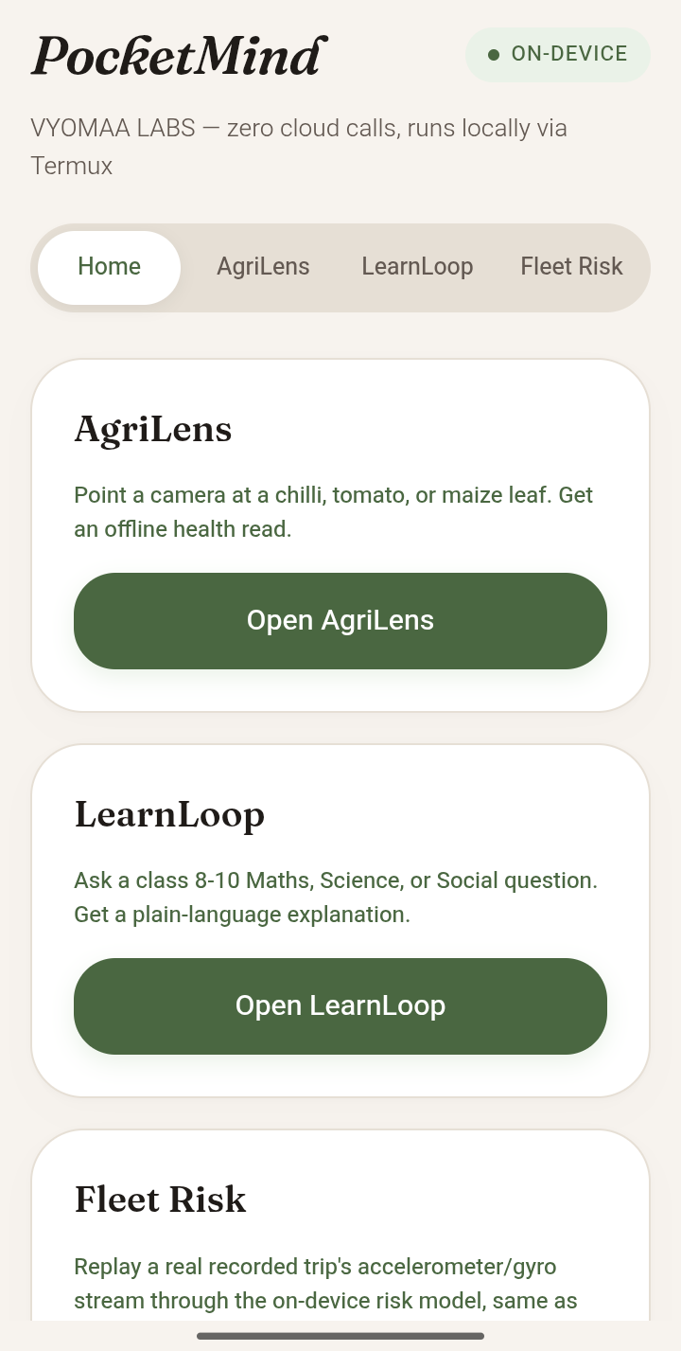
THE PLATFORM
Build the engine once. Serve farming, learning, health, environment and vehicles.
AgriLens
Now
Crop health
MedNotes
Next
Clinical records
LearnLoop
Now
AI tutor
EcoTrace
Next
Biodiversity map
Edge fleet unit
Now
Vehicle safety
VYOMAA LABS | PocketMind
4 / 12

Slide 6

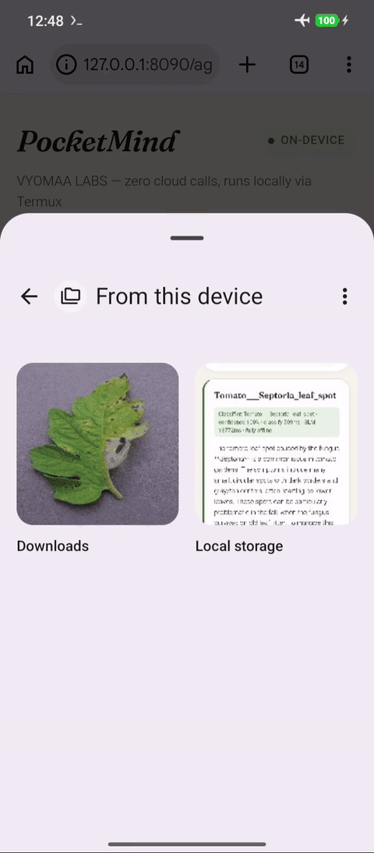
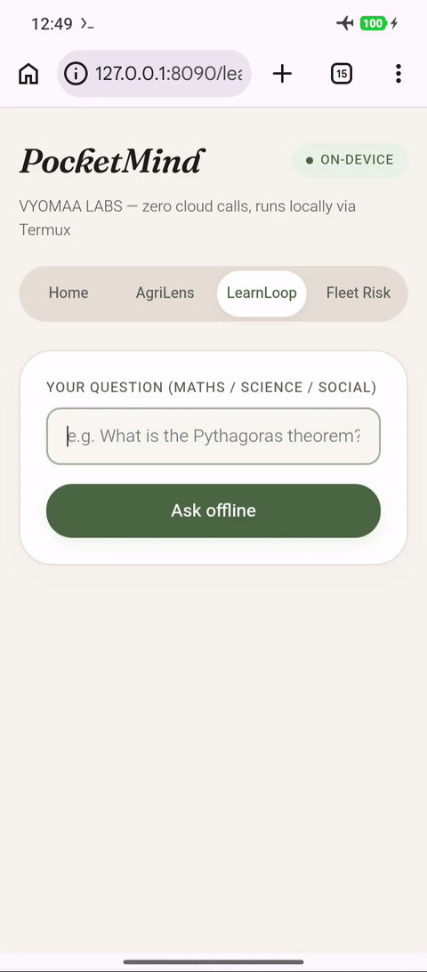
FIRST PRODUCTS
From a crop photo to a patient tutor, running offline.
AgriLens
LearnLoop
AgriLens
Point the camera at a crop and get an instant health read in a small app that needs no signal. Advice comes from a verified local advice bank.
Stage: Development and internal testing phase is freezed and Field testing with 5 Farmers of different crops.
LearnLoop
A patient practice partner for students to learn and think aloud in their own language, on the device they already have.
Stage: Phase 1 Development, battle testing is completed, Field testing with 10 rural students in addition to teaching AI technology for 5 hours a week
VYOMAA LABS | PocketMind
5 / 12

Slide 7
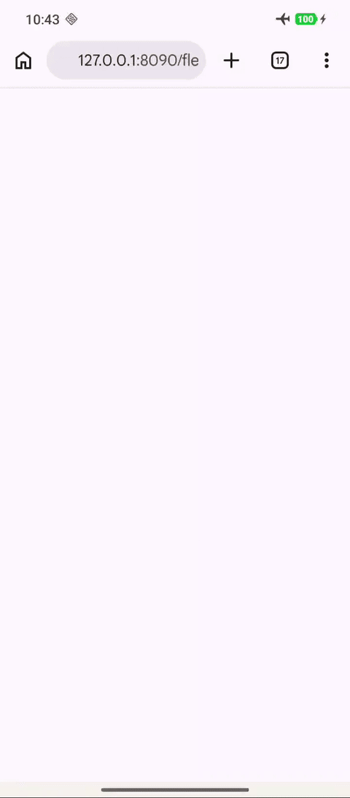
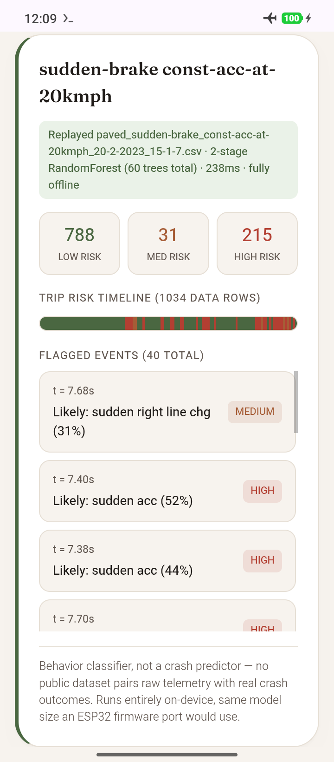
FLEETS AND NEXT SECTORS
Fleets are our earliest revenue wedge. Health and environment come next on the same engine.
NOW
Edge AI fleet unit
Crash detection
EV battery health estimation
Driver behaviour scoring
Works offline, syncs when connected
Stage: Crash detection development and driver behaviour scoring is completed and battle testing with various datasets. Field testing collaboration is done with Local Private Transportation.
VYOMAA LABS | PocketMind
6 / 12

Slide 8
BENCHMARKS & PERFORMANCE
LIVE DEVICE HARDENING
Measured, not estimated.
Hardened before demo.
Tested on: Redmi 24116RNC1I · Android 16 · 3.5GB RAM (~1.6GB idle free). No laptop numbers used.
Adversarially tested on the live device
Model
Answer time
Quality
Confidence gating (AgriLens knows what it doesn't know)
A 70% confidence floor catches a low-confidence photo and asks for a retake instead of presenting a false diagnosis.
1.5B params
Q4_K_M quantized
42–84s
Correct, grounded, no hallucination
0.5B params
task-tuned layers
15.3s single
15–55s load
Correct, grounded — zero quality loss
Grounding precision (LearnLoop never answers off memory)
Retrieval is filtered against common function words, so a shared word like "the" can't spuriously match an unrelated note.
THERMALS
34.0°C → 35.0°C
Battery temp across ~25-call run
MEMORY FOOTPRINT
~30–50MB
RAM truly free with model loaded
Input safety (Fleet Risk only reads its own trip folder)
Trip selection is checked against a real directory listing before any file opens — closing a path-traversal route.
AGRILENS
99.997%
Confidence on clean lab photo
FLEET RISK
54ms
Full 1,034-row trip replay
Open, tracked (LearnLoop's pace under a long session)
Answer time drifts from ~15s to 30–55s across repeated questions. Thermal throttling ruled out; tracked for a closer look.
On-device execution guarantee: Zero cloud latency dependencies, full offline operation maintained across all edge intelligence workloads.
VYOMAA LABS | PocketMind

Slide 9

DEPLOYMENT STATUS, HONESTLY
Where each piece actually stands
AgriLens
LearnLoop
Fleet Risk
AgriLens field pilot
IN PROGRESS
Piloting with 5 farmers
LearnLoop field pilot
IN PROGRESS
Piloting with 10 students
Database COMPLETE
On-device schema built, verified
Vehicle Hardware IN PROGRESS
Building the on-vehicle sensor layer
ACTIVE DEPLOYMENT
5 Farmers
Live agricultural field testing
ACTIVE DEPLOYMENT
10 Students
Classroom pilot evaluation
Cloud Compute IN PROGRESS
AWS aggregation layer being built
VYOMAA LABS · PocketMind

Slide 10
VISION & ROADMAP
A better India ahead: 100+ sector-specific models
100+ Models, On Any Smartphone
Once the architecture layers, training process, and performance benchmarks are finalized across sectors, the target is 100+ fully-trained, customized models — each tuned to its own sector the way AgriLens and LearnLoop already are.
All runnable on a smartphone of even the lowest practical configuration.
Where Latency Is Headed
These are unoptimized-pipeline numbers, not a ceiling
The model's own layers and routing between retrieval and generation are actively being tuned — newer quantization, decoding, and routing algorithms are being tested now.
TODAY
15–55s
per answer
TARGET, END OF 2026
A couple of seconds
per answer
Aligned with National Missions
Startup India / DPIIT recognition
IndiaAI Mission
Digital Agriculture Mission
PM eVidya / NEP 2020
VYOMAA LABS claims no formal affiliation with any of these programs beyond DPIIT recognition itself — the aim is to build toward the same goals, for the same people.
VYOMAA LABS · PocketMind

Slide 11
MARKET SCOPE
Hundreds of millions need AI but lack the internet and budget cloud AI demands.
958M
14.7 lakh
14.6 crore
7.4M
Active internet users in India; about 548M (57%) in rural areas.
Schools; 63.5% have internet.
Operational farm holdings; 86% small or marginal.
Commercial vehicles on Indian roads; about 3.5M with telematics.
Source: IAMAI, 2025
Source: UDISE+ 2024-25
Source: Agriculture Census 2015-16
Source: Brickwork, 2024
An active internet user does not always have a reliable connection in the field or classroom.
VYOMAA LABS | PocketMind
10 / 12

Slide 12
BUSINESS MODEL
Free or low-cost for people. Paid by institutions that already have budgets.
Schools and universities
Agri co-ops and FPOs
Commercial fleets
Per-seat and per-institution licences for LearnLoop.
Farmer advisory subscriptions and local crop-knowledge packs.
Edge hardware unit plus a per-vehicle monthly subscription.
Developers and OEMs
Governments
Clinics (next)
PocketMind SDK licence and domain model packs.
Deployment, localisation and citizen-service contracts.
MedNotes licence per practitioner.
VYOMAA LABS | PocketMind
11 / 12

Slide 13
ROADMAP AND ASK
Our mission: AI accessible to all. Next 12 months: from pilots to paying institutions.
12-month roadmap
0-3 months
Harden PocketMind on mid-range phones; launch the website
3-6 months
Pilots with a school, FPO or KVK and a fleet; first letter of intent; first government pilot application
DPIIT ask
Startup India benefits, access to government procurement and grants, and IP support.
6-9 months
First paying institutional customers; local-language packs
9-12 months
Expand to more districts and states; seed or grant funding
VYOMAA LABS | PocketMind
12 / 12

Slide 14


DEMO & RESOURCES
See it live: Everything in this deck, interactive
INTERACTIVE
VIDEO
Full Product Site
Full Demo Video
Explore full architecture breakdown, live on-device demo recordings, measured performance metrics, and in-depth reliability notes.
Watch core tools in action with a complete, narrated walkthrough detailing the underlying system architecture.
vyomaalabs.github.io/pocketmind
vyomaalabs.github.io/pocketmind/media/demo-full-narrated.mp4
VYOMAA LABS · AI in every hand, for a future-ready India.
VYOMAA LABS · PocketMind

